Slide 1
DINESH R
Final Project
3/21/2024 Annual Review

Slide 2
SENTIMENT ANALYSIS
3/21/2024 Annual Review

Slide 3


AGENDA
i.Problem statement
ii.Project overview
iii.Who are the end users?
iv.Your solution and its proposition
v.The wow in your solution
vi.Modeling
vii.Result
3/21/2024 Annual Review

Slide 4

PROBLEM STATEMENT
This project aims to develop a machine learning model to classify text data as positive or negative sentiment.
3/21/2024 Annual Review

Slide 5

PROJECT OVERVIEW
This presentation will showcase the development of a sentiment analysis model using Logistic Regression. We'll explore data exploration, feature engineering, model training, and evaluation.
3/21/2024 Annual Review

Slide 6

WHO ARE THE END USERS?
Businesses can utilize this model for social media sentiment analysis, understanding customer reviews, and gauging brand perception.
Researchers can leverage this approach for sentiment analysis in various domains like political discourse or product feedback analysis.
3/21/2024 Annual Review

Slide 7

YOUR SOLUTION AND ITS VALUE PROPOSITION
The solution is a text classification model built using Logistic Regression. It analyzes text data and predicts its sentiment (positive or negative). This offers benefits like:
Automated Sentiment Analysis: Classify large volumes of text data efficiently.
Data-Driven Insights: Gain insights into customer sentiment and public opinion.
Improved Decision Making: Make informed business decisions based on sentiment analysis.
3/21/2024 Annual Review

Slide 8

THE WOW IN YOUR SOLUTION
Simplicity and Interpretability: Logistic Regression is a well-understood model, providing interpretable results for understanding sentiment indicators.
Scalability: The model can be easily scaled to handle large datasets.
Customization: The model can be adapted to different domains by fine-tuning techniques
3/21/2024 Annual Review
‹#›

Slide 9
MODELLING
Data Preprocessing:
Removed HTML tags and special characters.
Lowercase text and extracted emojis.
Applied stemming to reduce words to their root form.
Feature Engineering:
Used TF-IDF vectorizer to convert text into numerical features, capturing word importance.
Model Training:
Employed Logistic Regression with cross-validation for robust sentiment classification.
Evaluation:
Measured model accuracy on unseen test data.
3/21/2024 Annual Review
‹#›

Slide 10
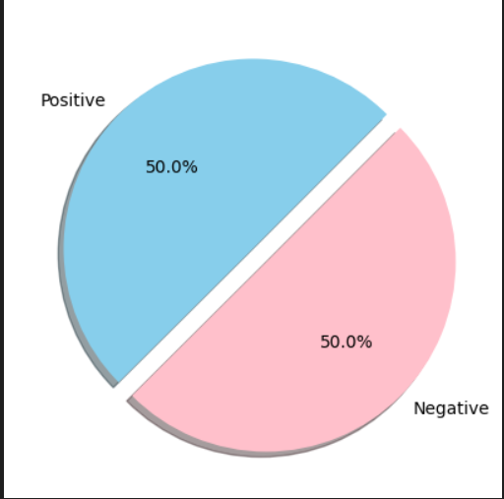

RESULTS
SENTIMENTS IN TRAINING DATA
FINAL ACCURACY
Demo Link
3/21/2024 Annual Review
‹#›

